Slide 1
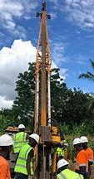
Tanzanian ministry of water: Decision Support tool
Booz Allen Hamilton INC. internal
WATERPOINT MAINTENANCE PREDICTOR
JULY 2021

Slide 2

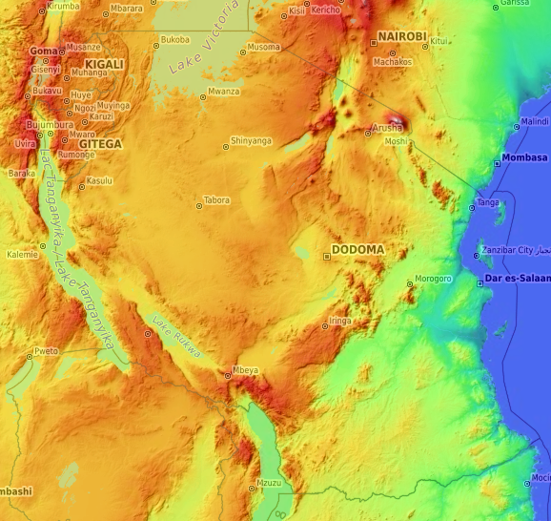
Agenda
Problem
Data exploration
observation and features
Current results
What’s next
Topographical Map of Tanzania
Latitude: -6.36 Longitude: 34.88
Elevation: 3839 ft

Slide 3


Tanzania water pump challenge
Problems:
Delivering continuous clean water throughout Tanzania
Waterpoints failing before maintenance can be accomplished
Many Tanzanian women and children collected water several kilometers away through elevations and rocky-terrain
Contaminated water supplies through inadequate sewage systems and 17% of the population practicing open defecation.
Background:
U.S. Government has been invested in the health and education of Tanzania since 1960
At 61.5 4 million Tanzanians, roughly 45% live in rural areas and do not have regular access to clean water (w/in 30 min distance).
Solutions:
Predict future functionality and make future resource allocations.
Water point system is approximately 100K Precision maintenance can potentially double life of system
Lifecycle of water points is approximately 5-6 years in Tanzania, maintenance could double life span

Slide 4
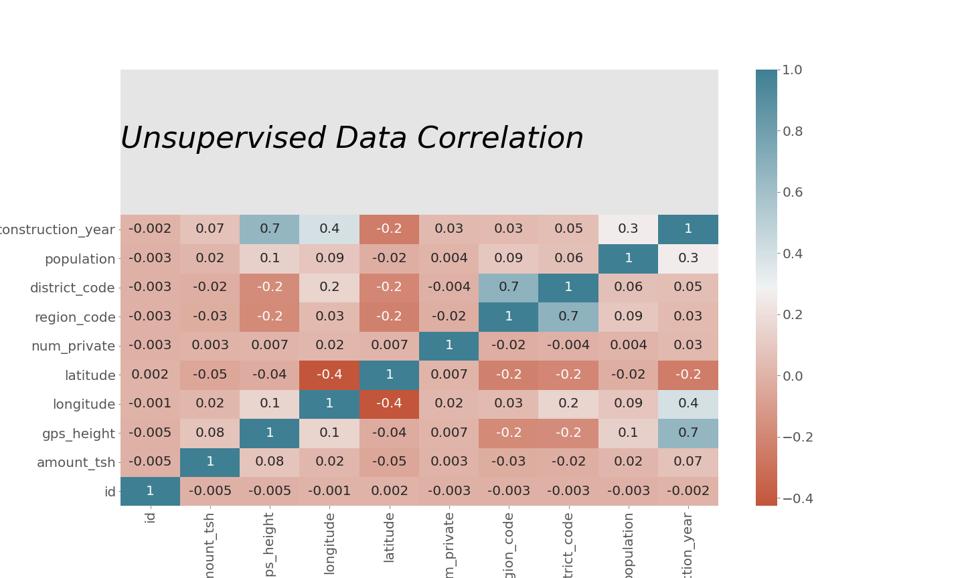
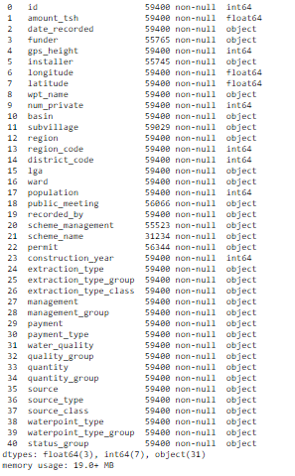
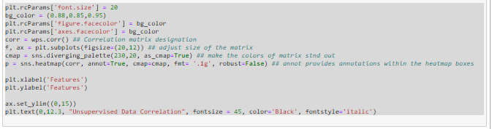
Observations and features
High Data correlation
between Year of construction:
Longitude
Elevation
Population
Minor Data correlation
between longitude:
District code
Elevation
Note: Correlation chart only used numerical values for correlation

Slide 5
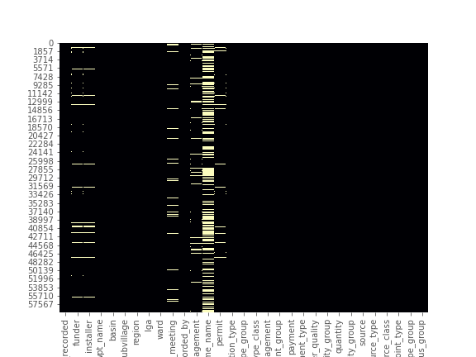
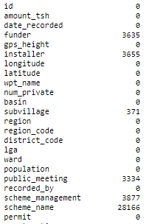
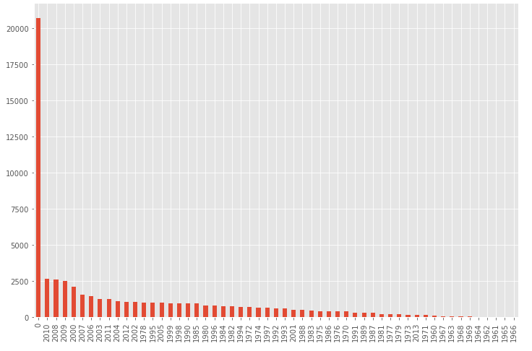
Deeper look at data
Number of Records Missing
For majority of missing information there is a negligible amount of missing data.
Scheme name has the most missing fields at 28K fields missing information,
possibly not an important field of data
Number of Recorded Dates set to 0
Nearly 30k records had the year a water pump was established at 0.
Historically normal date changes suggest to use 1970 (computer system epoch) instead changed to 1959 to mitigate data skewing
Possibly denotes date prior to this effort was formalized.
Note: High number of 0 values have caused outliers and possibly skews the data correlation, to have potential effect on prediction models.

Slide 6
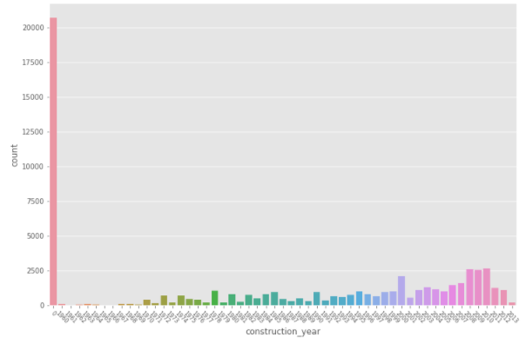
Data Transformation
Count
Additional processing was needed to accomplish machine learning models:
Mitigated 0 values in date to epoch
Zero’d out null values vice dropping information all together
One Hot encoding for categorical values

Slide 7
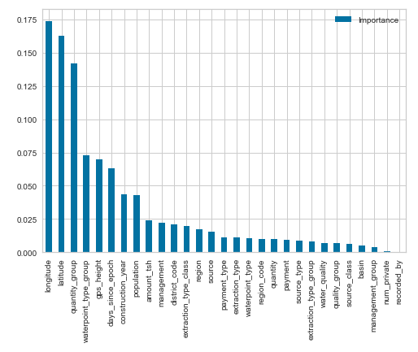
Current Results: decision tree classifier
Results after elimination of nulls
Decision Tree Classifier Increased prediction rates to approximately 75%
Most significant Features:
Longitude and Latitude
Quantity group
Waterpoint type group
GPS height
Top Features
Results prior to elimination of nulls
Logistics Regression current prediction rate was at 55%
Decision Tree pushed prediction rates to approximately 66 %

Slide 8
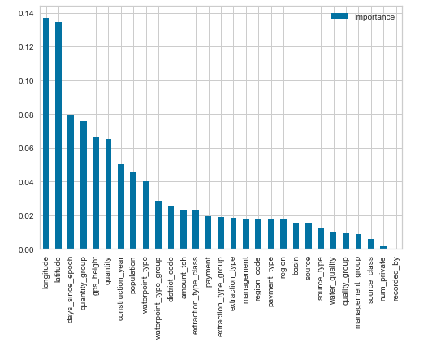
Current Results : Random Forrest classifier
Results after elimination of nulls
Random Forrest Classifier can predict up to 80%
Differences in features:
Approx. age of pumps (Days_since_epoch) switched with quatity group at almost the same rate
Then elevation vice waterpoint type group which was demoted to 10th important feature
Top Features

Slide 9
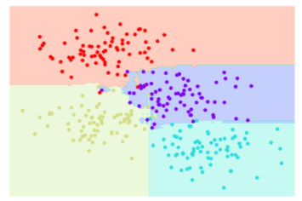
Random forest classifier

Slide 10
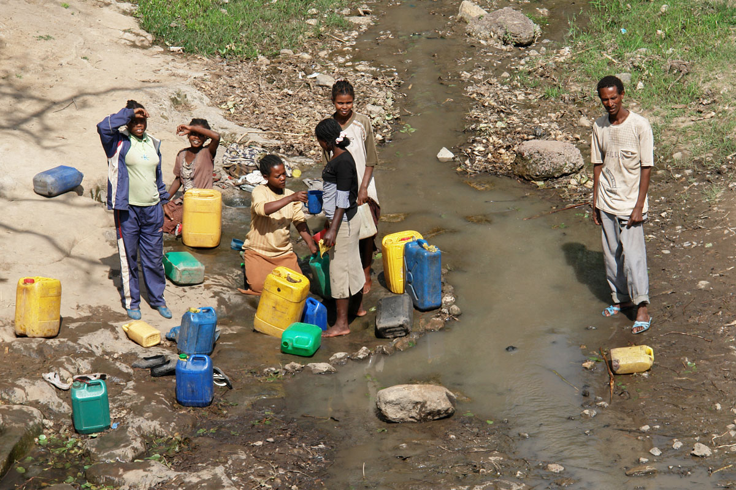
Next Steps
Visualize water points functional predictions/status on map and dashboard
Visualize confusion matrix and evaluate models' overall accuracy and precision
Further evaluate null records and correlated variables of data identified.
Explore additional models to increase predictive rates
Support Vector Machine
Naïve Bayes

Slide 11
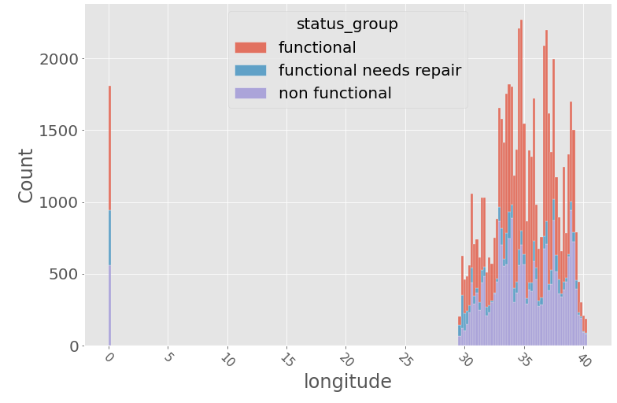
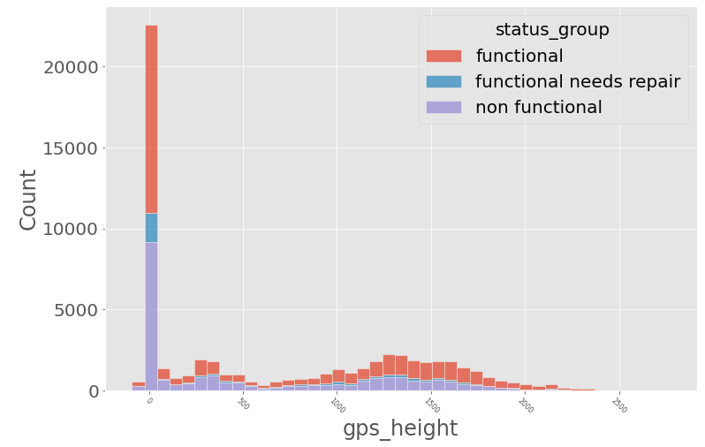
Further Correlations

Slide 12
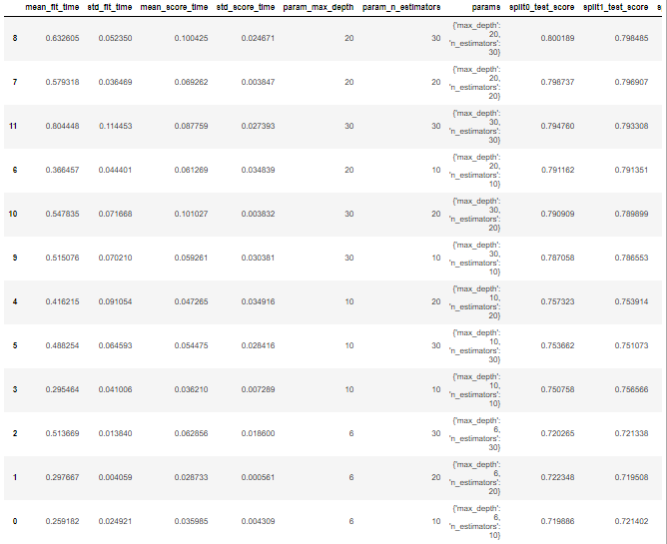
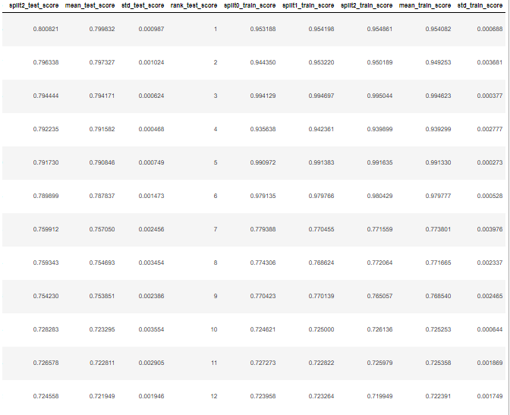
Results

